Slide 1
Digital Distribution
Personal Investing
2FA Automation Utility
By
Narasimhulu U

Slide 2
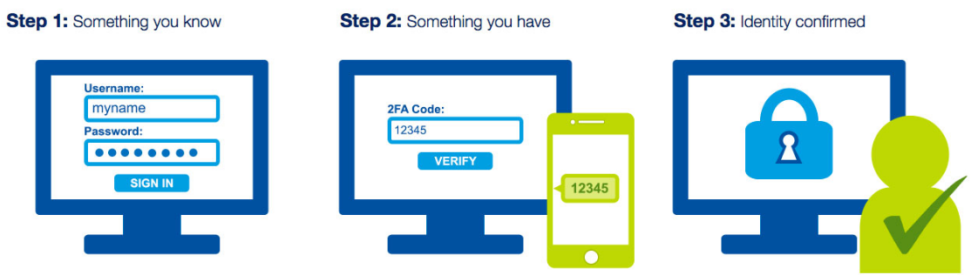
2FA Process
Two-factor authentication (2FA), often referred to as two-step verification, is a security process in which the user provides two authentication factors (Password & Passcode) to verify they are who they say they are.

Slide 3

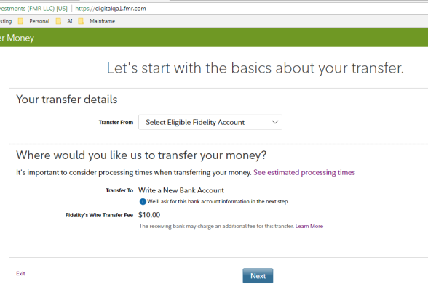
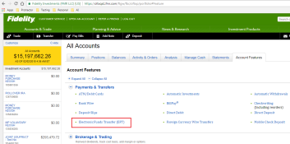

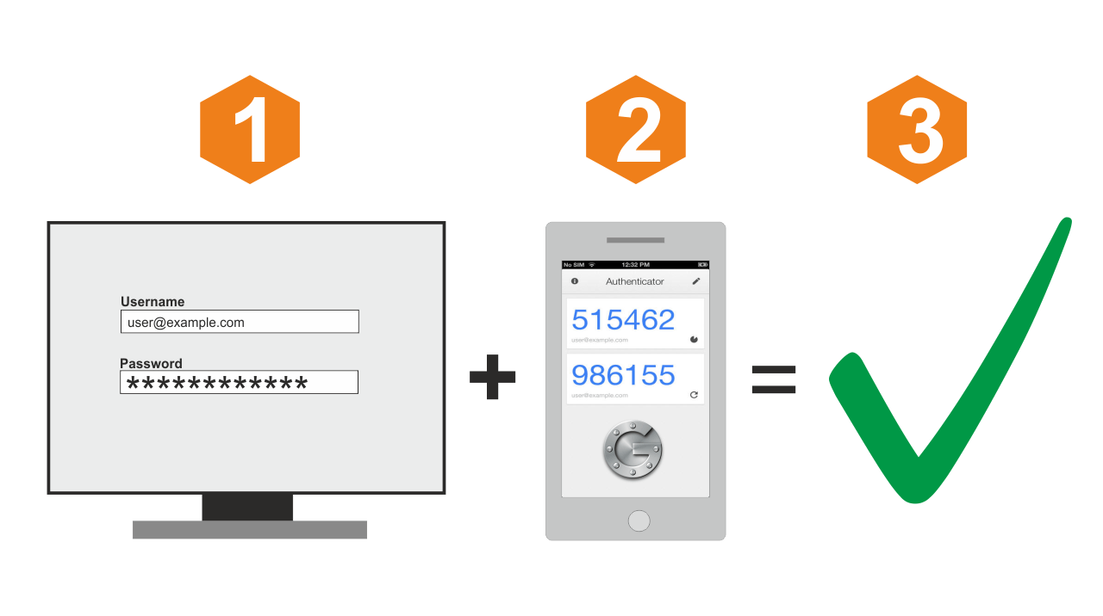

Application Development Phase
Validating Single Component

Slide 4

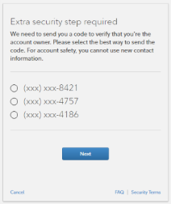


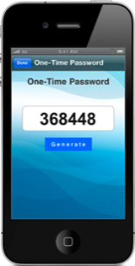
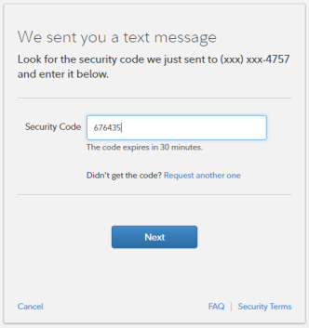



2FA Validation Current Flow
2FA Validation Automation Utility
2FA Passcode Generation Process
Passcode reading and authenticating Process

Slide 5
Benefits
2
Can be utilized across Enterprise
90% effort reduction
3
1
Eliminating wait time for device access
2FA usage in the near future
Bank Wire
Electronic Fund Transfer
PIN / Password Change

Slide 6

Demo

